Slide 1


An alumni connect platform for colleges
Campus - Connect
Team - SpiritX
Sanskar Koserwal, Jaideep Jaiswal, Kushagra Taneja ,
Sneha Chinchkar, Trijay Patel

Slide 2
Problem Statement
What features should a digital alumni engagement platform include to strengthen connections between alumni and students, facilitating mentorship, career guidance, and professional networking?
Solution
40%
40%
20%
A digital alumni engagement platform should leverage AI-driven matchmaking for mentorship, career guidance, and networking. It should facilitate seamless communication, event management, and content sharing to strengthen alumni-student connections and institutional ties.

Slide 3

Tech Stack
Node.js
MongoDB
React.js
Express.js
Key Features
Mentorship by alumni
Event organisation by alumni
Job offering/referral available
Alumni Directory
Open-Source Project Sharing

Slide 4
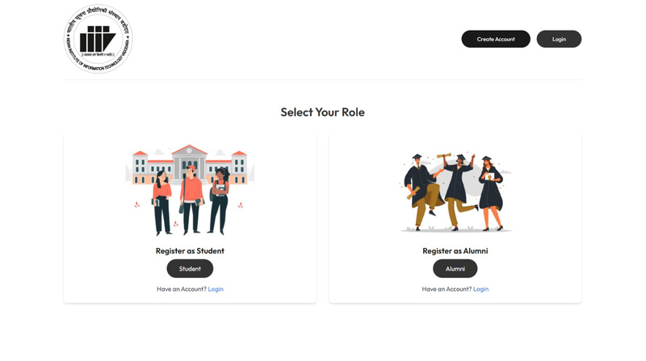
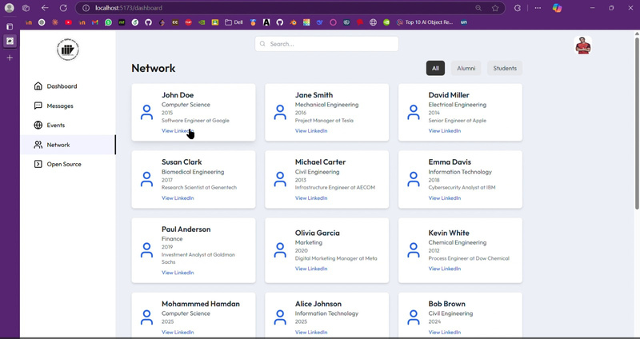
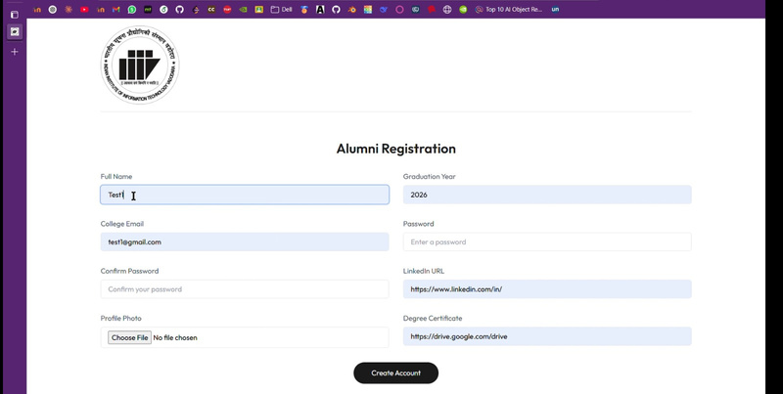
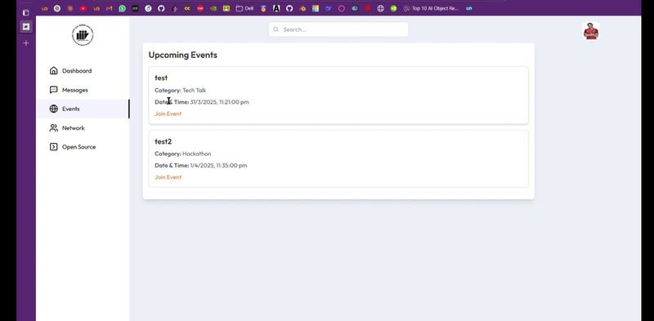
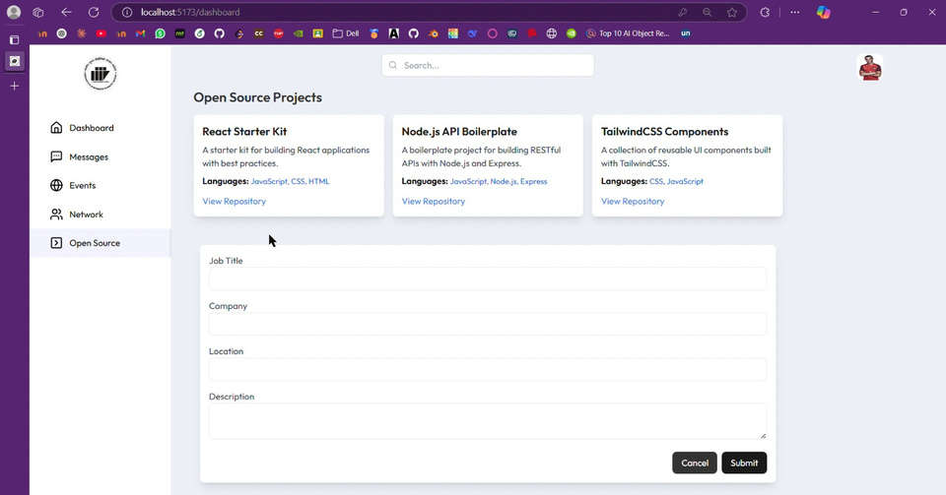
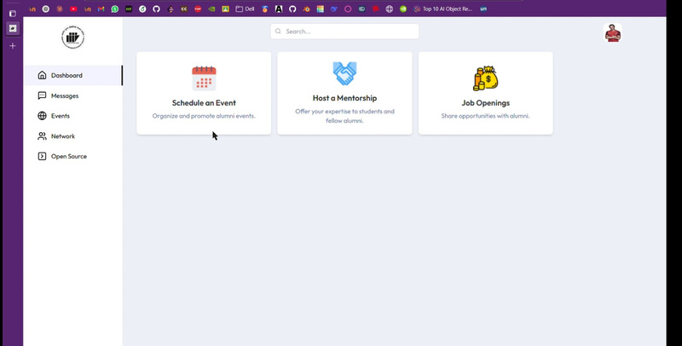

Demonstration
Video Demonstration of Project

Slide 5
Thank You
Let us have a great community ahead!

